Slide 1
Expressing an Opinion Agreeing & Disagreeing Art
www.eltea.org

Slide 2
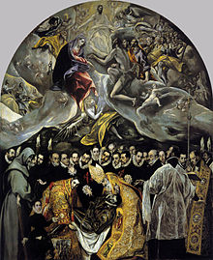
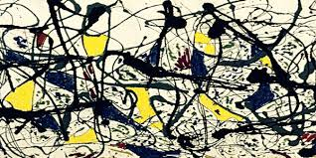
●Are both paintings a work of art? ● What do people want to achieve through art?

Slide 3
‘Art speaks where words are unable to explain.’
‘Modern art is art that kindergarten kids could make.’

Slide 4
The following creations claim to be great works of art . Do you agree?

Slide 5
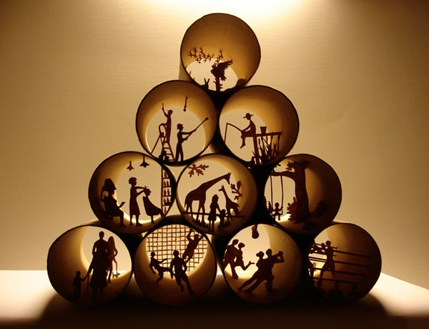
Toilet Paper Rolls. Anastasia Elias uses toilet paper rolls to create miniature scenes of life.

Slide 6
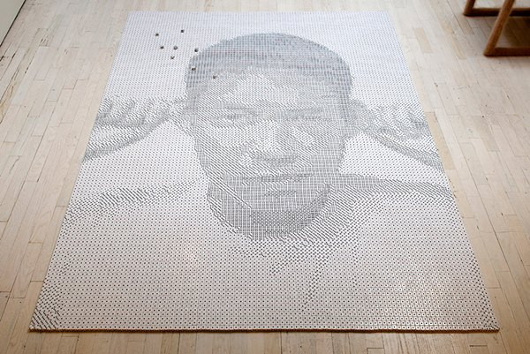
Dice. Frederic McSwain created this portrait as a tribute to his friend, who died from suicide. The portrait was made using 13,138 dice – one for each day of Tobias’ short 35 years.

Slide 7
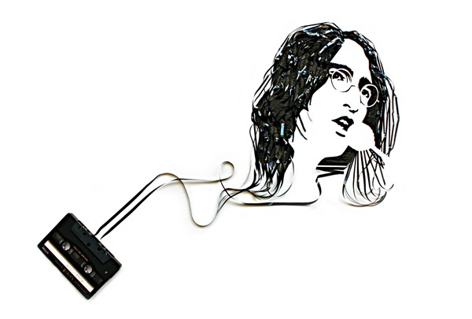
Cassette Tapes. Erika Iris Simmons uses old cassette tape to create popular celebrity portraits.

Slide 8
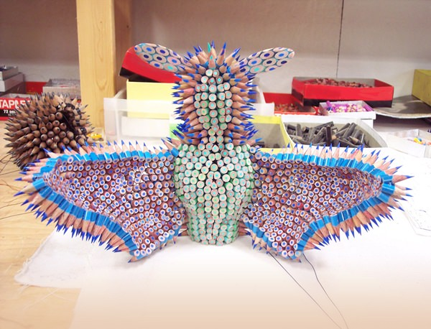
Pencils Sharpened pencils have become Jennifer Maestre’s main material for creating sculptures.

Slide 9
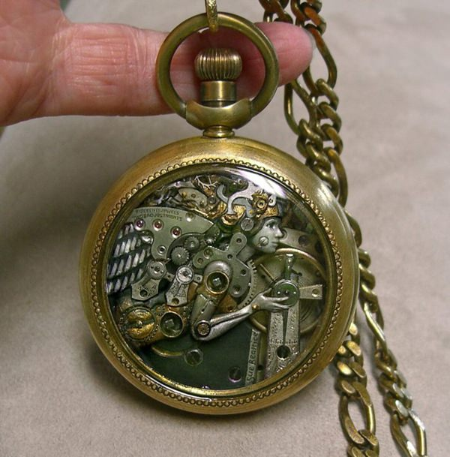
Old Watch Parts. Susan Beatrice uses old watch parts to create steampunk sculptures.

Slide 10
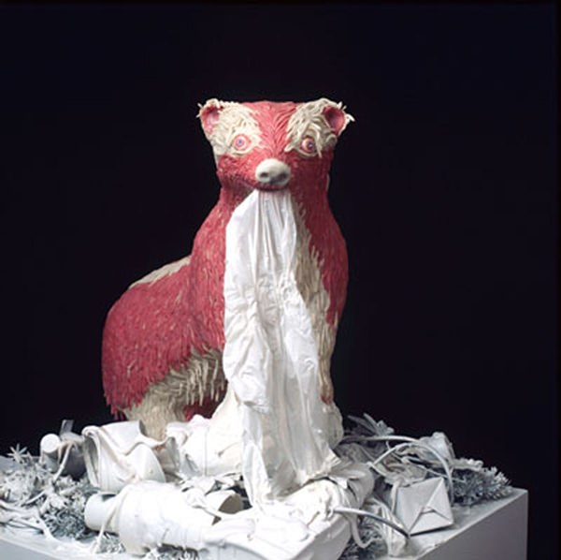
Chewing Gum. Maurizio Savini uses chewed bubblegum to create sculptures

Slide 11
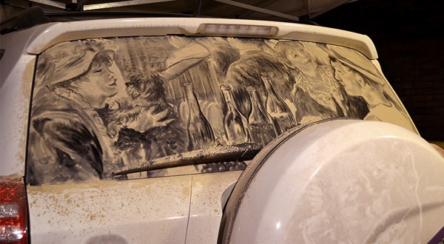
Dirty Car. Scott Wade purposely makes his car dirty (sometimes using artificial dirt) so he can create wonderful “dirty” art on the back of his car window.

Slide 12
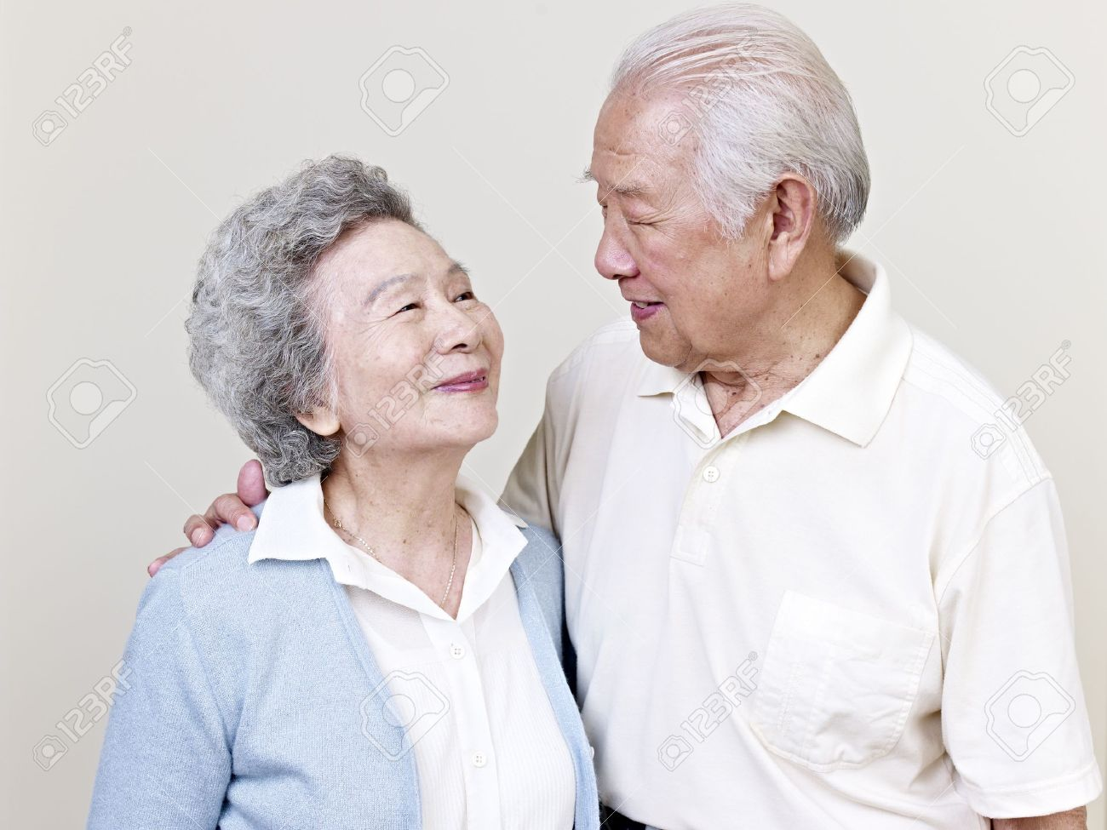
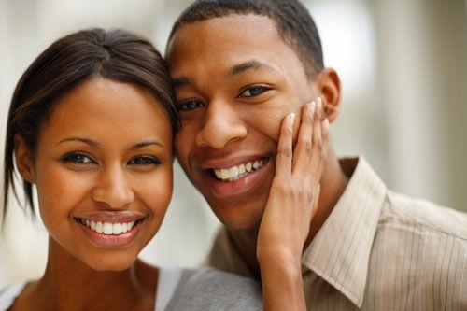

Slide 13
Student A Student B A. Tate Modern D. National Gallery B. Natural History E. London Transport Museum Museum C. V&A F. British Museum

